Slide 1






Episode 5:
Video streaming platforms

Slide 2


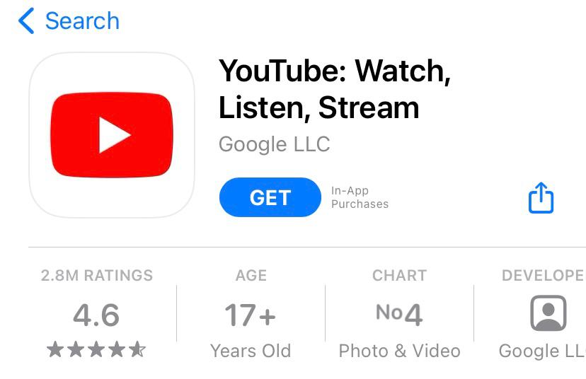


Watch !
Check the age limits!
Some platforms are not appropriate to your age.
But why?

Slide 3
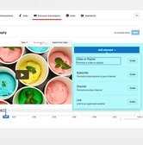

Advertising banners
Content linked in
the comments
Do not click!
You might see inappropriate content or download viruses that will harm your smartphone
or tablet

Slide 4

Advertising banners
Congratulations you’ve won
SCAM
Earn money easily
Hackers will try their best to push you to share with them very important information such as your
Email address
Home address
Telephone number

Slide 5


Advertising banners
Content linked in
the comments
Recommended videos
Do not click on recommended videos, there might be content not suitable for your age

Slide 6








Slide 7



Adult streaming platforms and their content are unsuitable for kids your age and can cause you harm.
Always use age-appropriate platforms for kids your age and only use them with your parents' authorisation
Always ask a trusted adult to help you use streaming platforms
If you use gaming consoles remember to use them like streaming platforms. Always use the same rules for all devices connected to the Internet!

Slide 8

See you soon on www.itu-cop-guidelines.com

